Slide 1

YouTube Sentiment Analysis
Group 15
Abhishek Verma - B.Tech IT 1805213004
Harsh Jalan - B.Tech IT 1805213022
Sanjay Gautam - B.Tech IT 1805213049
Under the Supervision of
Dr. Natthan Singh
Mr. Mahima Shanker Pandey
Department of Computer Science and Engineering
Institute of Engineering and Technology
Dr. A.P.J. Abdul Kalam Technical University, Lucknow, Uttar Pradesh

Slide 2
YouTube is a sea of content
YouTube is one such social media platform that hosts majority of the population.
The issue with this platform is that the majority of the population is unconsciously consuming biased media content.
The analysis is performed in real time so that any user who is consuming some content on YouTube gets an idea that whether the content being played is biased or not.

Slide 3



Problem Statement
The project aims to analyze the caption displayed and match it with the video content for appropriateness.
Suggests a correct caption sequence in case of faulty and wrong one.
It also aims to perform sentiment analysis on YouTube videos and perform categorization.

Slide 4
Python with Natural language Processing
Natural language processing (NLP) is the ability of a computer program to understand human language as it is spoken and written -- referred to as natural language
NLP combines computational linguistics—rule-based modeling of human language—with statistical, machine learning, and deep learning models. Together, these technologies enable computers to process human language in the form of text or voice data and to ‘understand’ its full meaning, complete with the speaker or writer’s intent and sentiment
The Python programing language provides a wide range of tools and libraries for attacking specific NLP tasks.

Slide 5
Data flow Diagram
Positive
Audio Video
Path Audio
Neutral Text
Negative
Text Polarity
Video to Audio
Sentimental analysis
User
Audio to Text
Polarity Analysis

Slide 6
Modules
Interface of the application
01
Convert video to audio
02
Convert audio to text
03
Speech-to-text API recognition
04
Polarity analysis of text.
05

Slide 7
Interface of the application
Python offers multiple options for developing GUI.
In this project we used tkinter
It is a standard Python interface to the Tk GUI toolkit shipped with Python.
Python with tkinter is the fastest and easiest way to create the GUI applications.

Slide 8
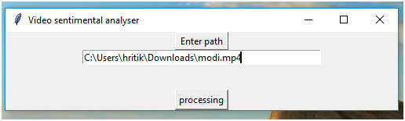
Input Format

Slide 9

Convert Video to Audio
MoviePy is a Python module for video editing, which can be used for basic operations
like cuts, concatenations, title insertions
video compositing (a.k.a. non-linear editing)
video processing to create advanced effects
It can read and write the most common video formats, including GIF.

Slide 10



Speech-to-text API recognition
Speech recognition is the process of converting spoken words to text. Python supports many speech recognition engines and APIs, including Google Speech Engine, Google Cloud Speech API, Microsoft Bing Voice Recognition and IBM Speech to Text.

Slide 11
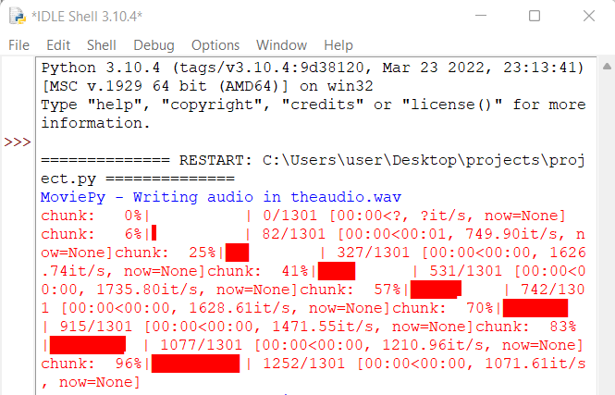
Video parsing process

Slide 12
Polarity Analysis
In this module we used VADER Sentiment Analysis.
VADER (Valence Aware Dictionary and sEntiment Reasoner) is a lexicon and rule based sentiment analysis tool that is specifically attuned to sentiments expressed in social media
It is NLP algorithm.
It uses a combination of A sentiment lexicon is a list of lexical features (e.g., words) which are generally labelled according to their semantic orientation as either positive or negative.

Slide 13
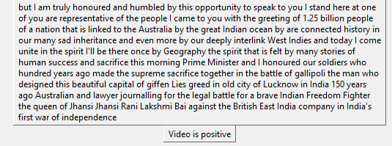
Output Format

Slide 14
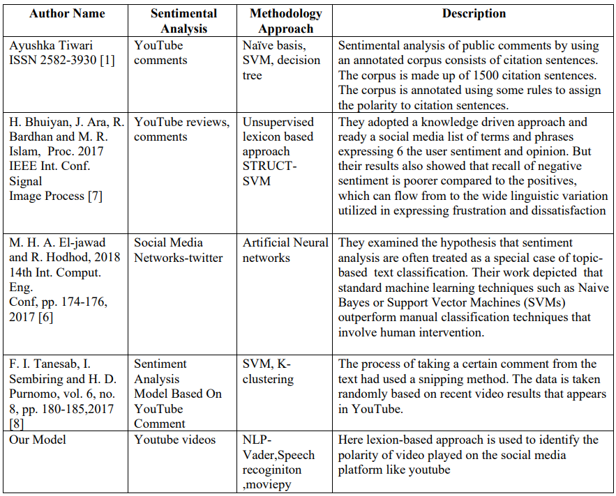
COMPARATIVE WORKS

Slide 15
Future scope
Making the model using real time values and work in real time.
calculating the accuracy of new model and comparing it with this model and see if there is little or no difference.
Training the model for recognition of other languages other than English.

Slide 16
REFERENCES
Ayushka Tiwari and Ritika Singh. “YouTube Comments Sentiment Analysis”. Date: May – 2021 International Journal of Scientific Research in Engineering and Management (IJSREM). ISSN: 2582-3930
Mehta, Munish, Kanhav Gupta, and Shubhangi Tiwari. "A Review on Sentiment Analysis of Text, Image and Audio Data." 2021 5th International Conference on Computing Methodologies and Communication (ICCMC). IEEE, 2021
H. Jelodar et al., "A NLP framework based on meaningful latent-topic detection and sentiment analysis via fuzzy lattice reasoning on youtube comments", pp. 4155-4181, 2021.
Chen H, Xie W, Vedaldi A, Zisserman A. Vggsound: A large-scale audio-visual dataset. In ICASSP 2020-2020 IEEE International Conference on Acoustics, Speech and Signal Processing (ICASSP). IEEE. 2020;721-725
Wang J, Yu LC, Lai KR, Zhang X. Tree-structured regional CNN-LSTM model for dimensional sentiment analysis. IEEE/ACM Transactions on Audio, Speech, and Language Processing. 2019 ; 28:581-91
M. H. A. El-jawad and R. Hodhod, "Sentiment Analysis of Social Media Networks Using Machine Learning", 2018 14th Int. Comput. Eng. Conf, pp. 174-176, 2017
H. Bhuiyan, J. Ara, R. Bardhan and M. R. Islam, "Retrieving YouTube video by sentiment analysis on user comment", Proc. 2017 IEEE Int. Conf. Signal Image Process. Appl. ICSIPA 2017, pp. 474-478, 2017
F. I. Tanesab, I. Sembiring and H. D. Purnomo, "Sentiment Analysis Model Based On Youtube Comment Using Support Vector Machine", vol. 6, no. 8, pp. 180-185, 2017

Slide 17


